Slide 1
Recommender system
Restaurants in Toronto

Slide 2
Problem Description
Nowadays, recommender systems are used to personalize your experience on the web, telling you what to buy, where to eat or even who you should be friends with. People’s tastes vary but generally follow patterns.
A recommender system is a simple algorithm whose aim is to provide the most relevant information to a user by discovering patterns in a dataset.
In this project, we build a recommender system to provide restaurant recommendation in the Toronto neighborhood based on their likings and past visits.

Slide 3
Data Description
Ratings data:
userId - the ID of the user who rated the restaurant.
Restaurant_id - the ID of the restaurant.
rating - The rating the user gave the restaurant, between 1 and 5.
timestamp - The time the restaurant was rated.
Restaurants data:
Id- the ID of the restaurant.
Venue – Restaurant name
Neighborhood – the neighborhood where the restaurant is located
Venue Longitude – Longitude data of the restaurant
Venue Latitude – Longitude data of the restaurant
Category – Restaurant category

Slide 4
Data Exploration

Slide 5
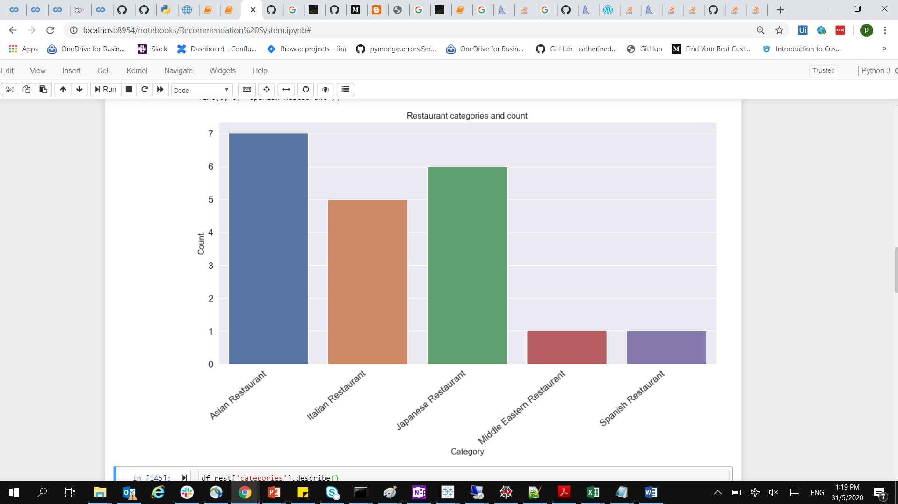
Restaurants in a Category

Slide 6
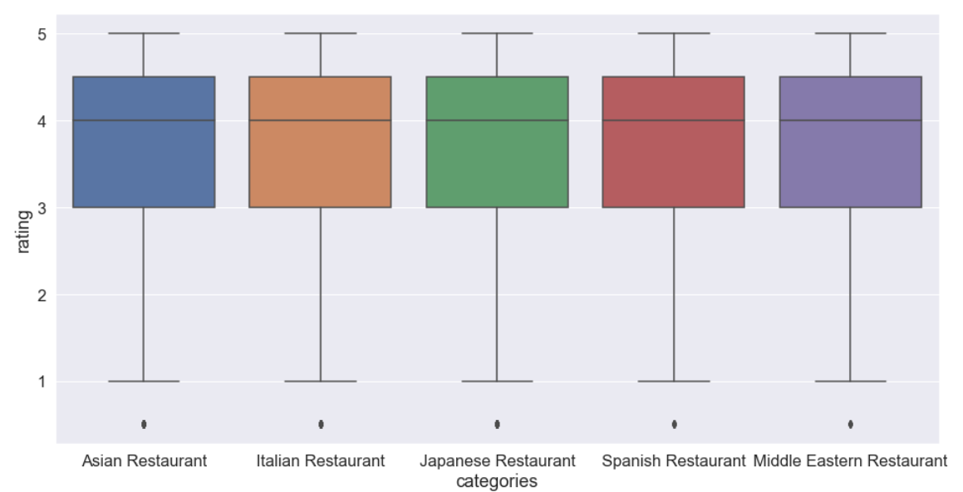
Restaurant Ratings By Category

Slide 7
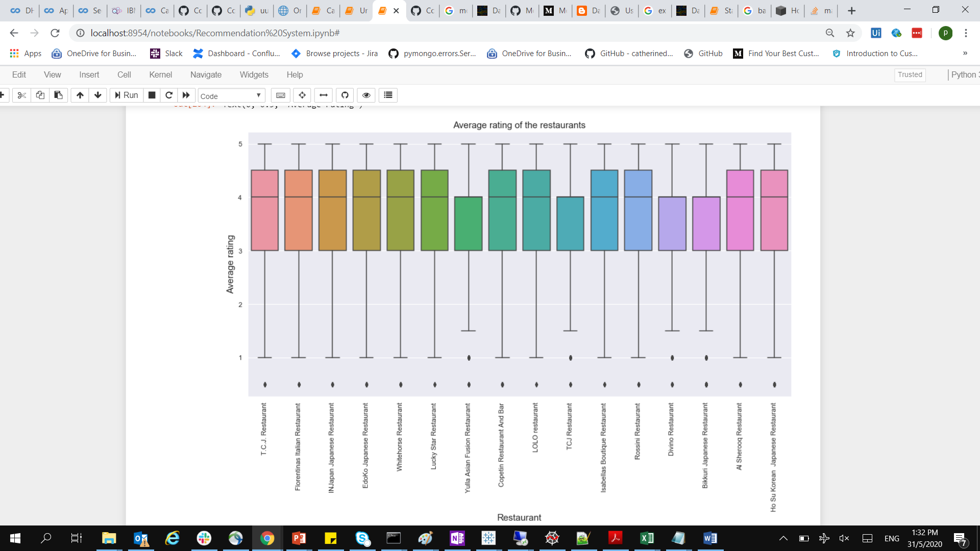
Restaurant Ratings

Slide 8
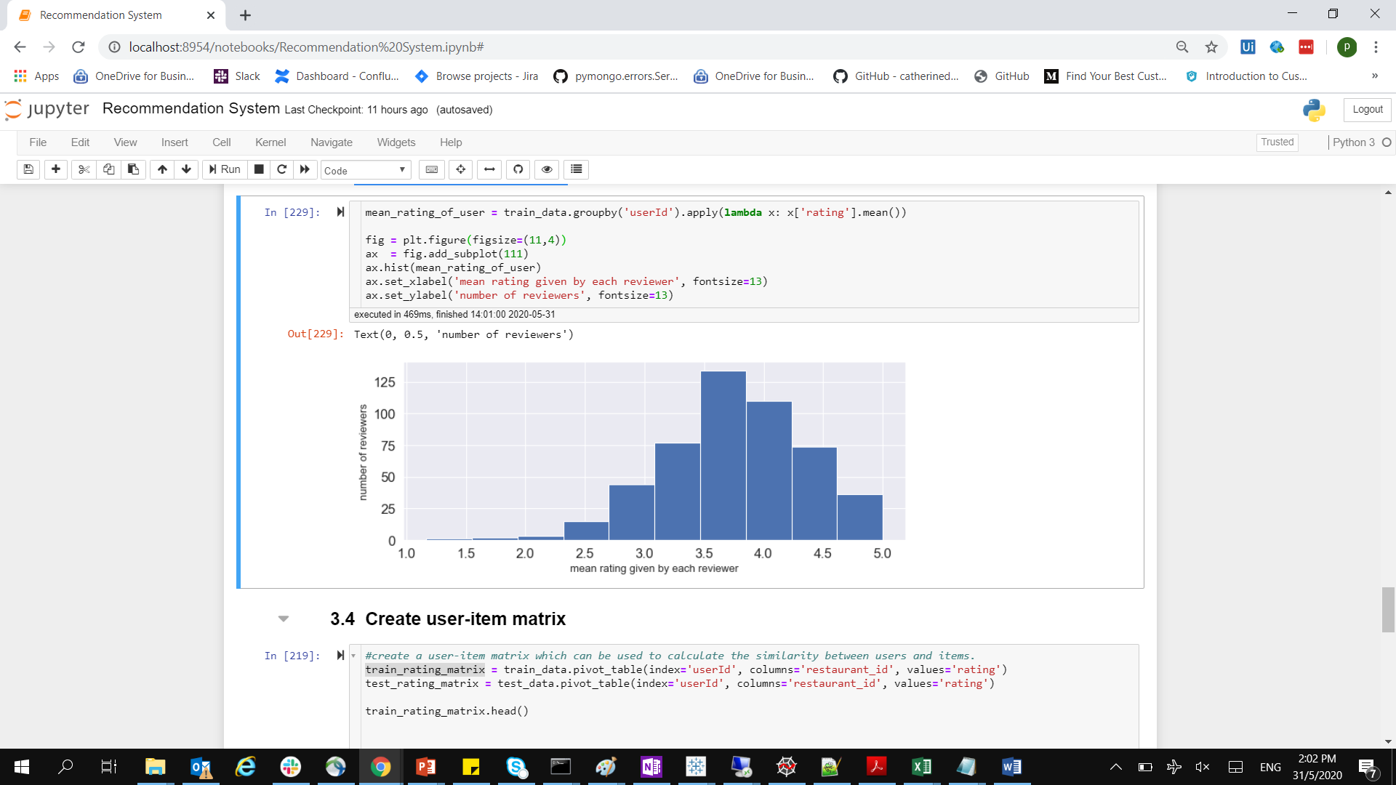
Rating Distribution by Customers

Slide 9
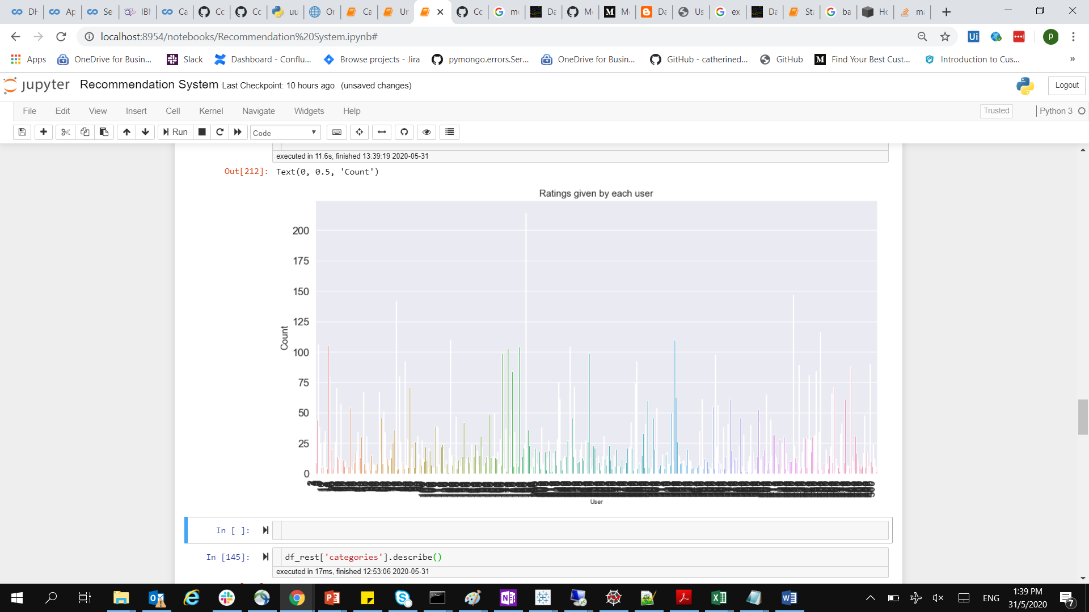
Customer Ratings

Slide 10
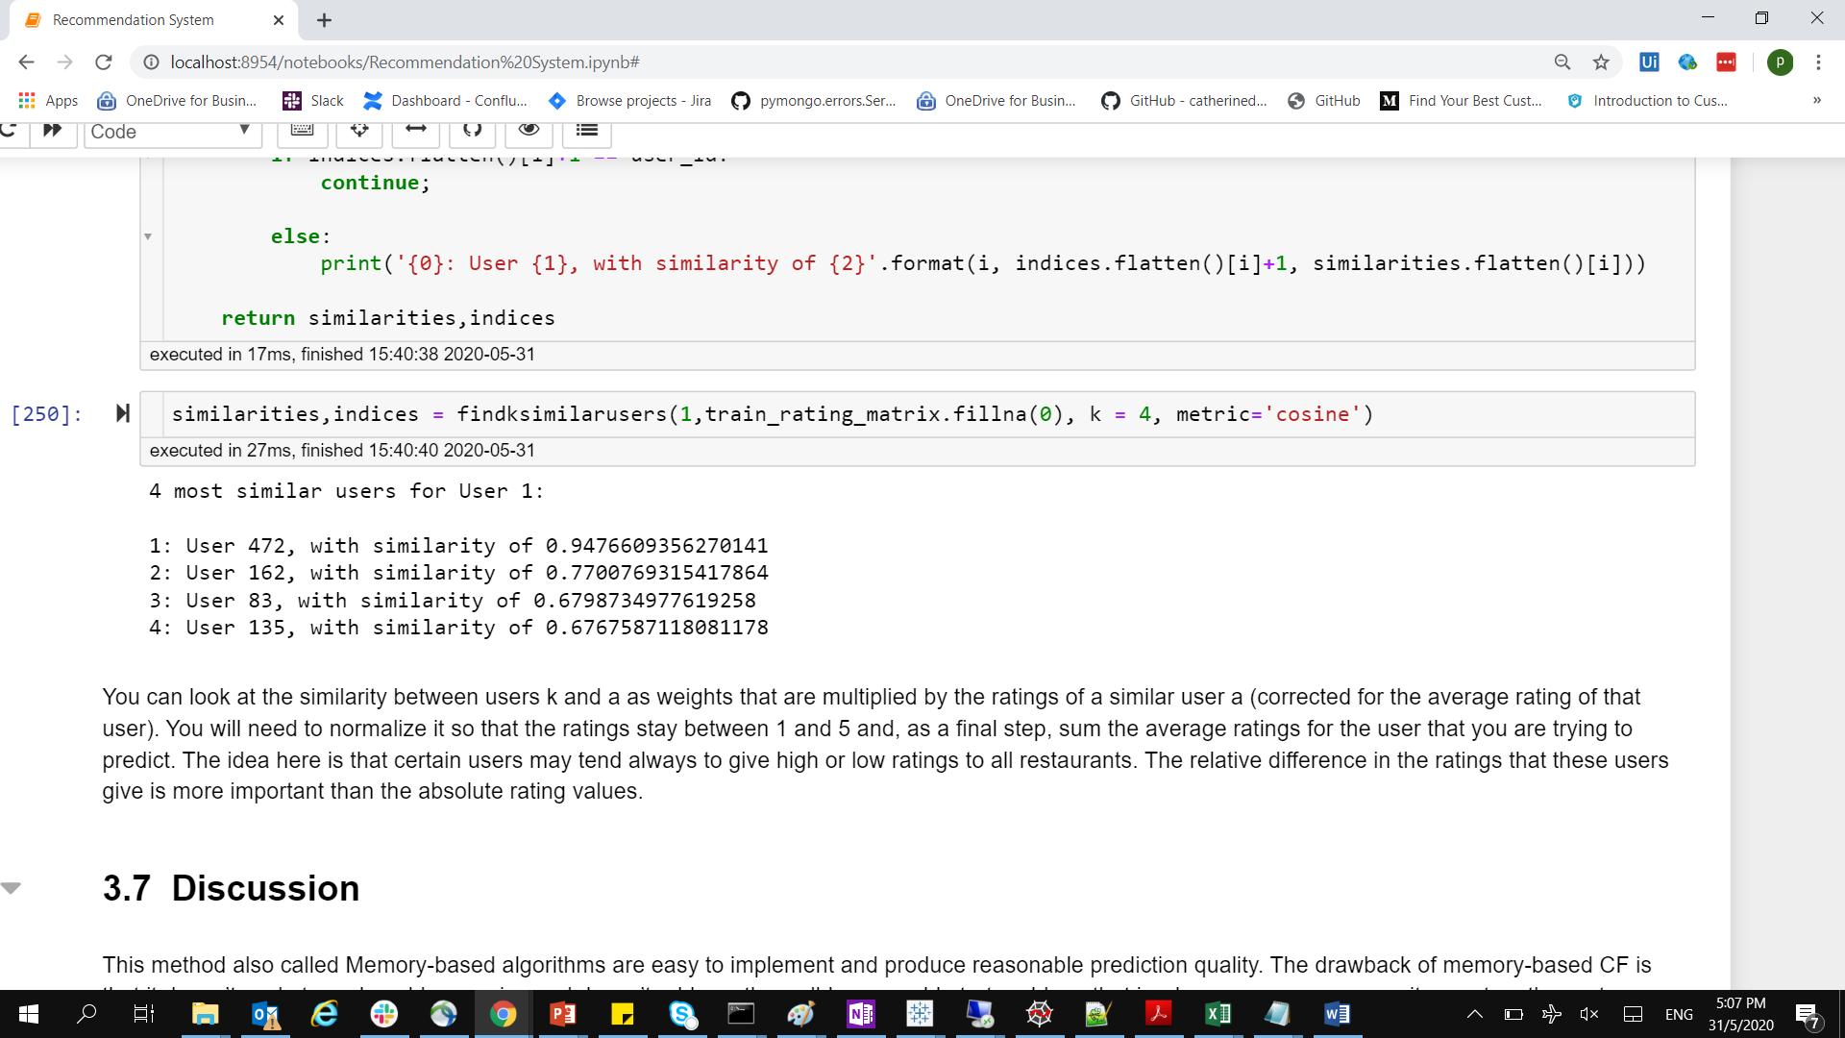
Results – Similar Customers

